Slide 1
Linear and Non-linear Regression
Brian McRee, Jacob Sanchez, Stephanie Bello
October 14, 2013

Slide 2
Theory

Slide 3
Method of Least Squares
Method used in all three parts
mathematical procedure for finding the best-fitting curve to a given set of points
minimizing the sum of the squares of the offsets (residuals) of the points from the curve

Slide 5
Linear Regression

Slide 7
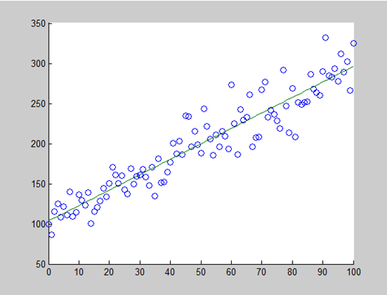
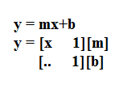

Slide 8
Non-Linear Regression

Slide 10
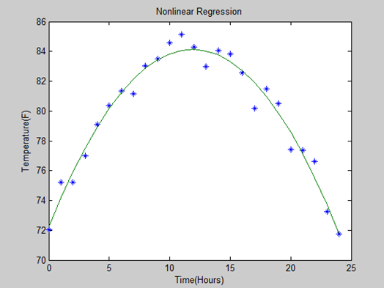

Slide 11
Sinusoidal Wave Estimation

Slide 13
